Slide 1
Electrifying Fleets and Heavy-Duty Vehicles
2021 NASUCA Mid-Year Meeting
June 14, 2021
Jason Frost

Slide 2
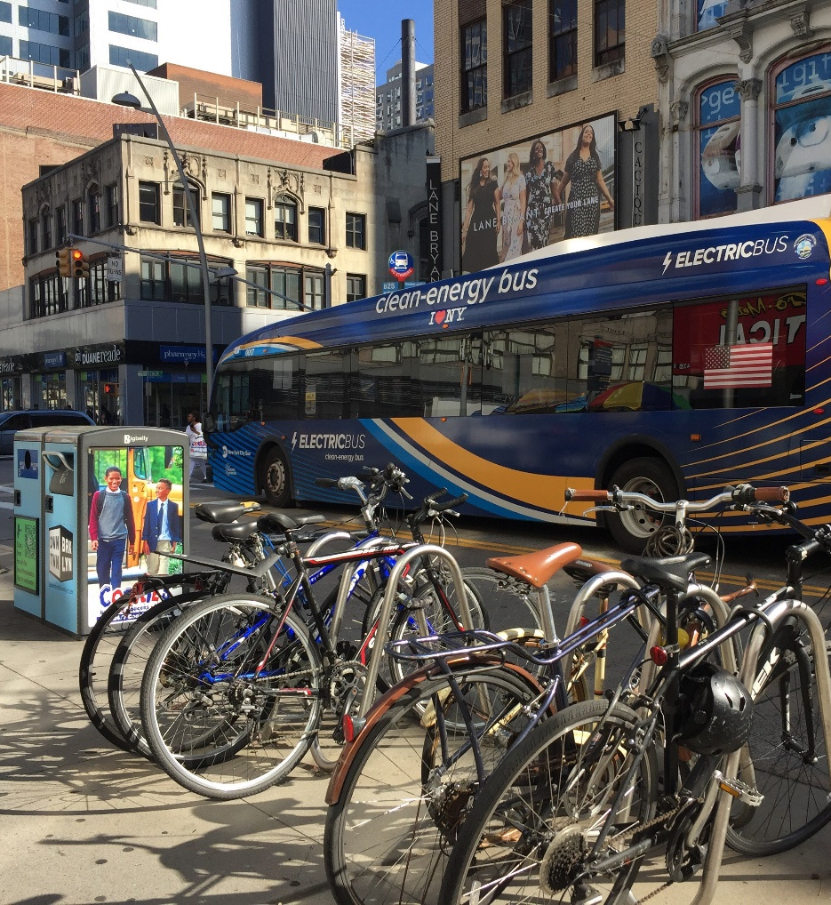
Fleet electrification in the US
The number of available electric fleet vehicles is increasing rapidly
According to Calstart, the number of available zero emissions heavy-duty truck models in the US will increase from 8 models in 2020 to 28 models in 2023
Companies have announced significant investments in EV fleets, including Amazon’s plan to purchase 100,000 electric delivery vans by 2030
Buses, delivery vans, and drayage vehicles are likely to be electrified first

Slide 3
EV fleet deployment will accelerate over the next decade
Total cost of ownership (TCO) for electric fleets is declining
TCO parity already being reached in some segments and coming soon in others
Costs vary between vehicle types and uses
Some states are moving to accelerate the market
California Advanced Clean Trucks rule requires 30%-50% of new sales to be electric by 2030 (depending on the type of truck)
15 states and DC signed a medium- and heavy-duty zero emission vehicle MOU

Slide 4
Fleet electrification cost drivers
While EV total cost of ownership is approaching parity with gas and diesel vehicles, upfront costs remain high
Charging infrastructure deployment is another significant barrier
According to the Electrification Coalition, a DC fast charger can cost $20,000-$50,000
Slower chargers are often not suitable for larger trucks or buses
Demand charges can also increase the cost of fleet electrification
Fleets charging simultaneously can consume large amounts of energy
For example, a bus depot housing 100 transit buses charging at 50 kW would consume 5 MW of electricity

Slide 5
Integrating fleets into the grid
Fleet vehicles have a few characteristics that distinguish them from passenger EVs
Typically in use more of the time
Often have repeated, predictable routes that can make electrification easier
Opportunities to work with a single fleet operator to impact charging behavior for a large number of vehicles
There may be opportunities for utilities to facilitate fleet electrification
Simplifying interconnection processes for large new charging loads
Rate designs that take advantage of EV load flexibility
Assistance with siting in locations with more available capacity for new load
Targeted make-ready infrastructure investments

Slide 6
Benefits to consumers and society
Electrification of fleets can have a big impact on communities they operate in
Heavy-duty vehicles are responsible for a disproportionate amount of criteria pollutant emissions, such as particulates, that have direct health impacts on people who live, work, or travel nearby
The American Lung Association found that transitioning to EVs could result in $72 billion in avoided health harms, including 6,300 premature deaths and 93,000 asthma attacks
EVs also emit less noise and less heat (particularly important for urban environments that suffer from heat island effect)
Key strategy to mitigate climate change

Slide 7
EVs can drive rates down
EVs represent a large new load to the system
But will take decades to fully emerge
Additional, flexible load can use existing grid infrastructure more efficiently
We calculated that in California passenger EVs contributed $800 million more in revenue than they cost to serve between 2012-2019
Better charging management and even vehicle to grid technology can help lower costs even further in the future
Analysis of EV impacts on rates across the country coming soon
To help attract this load and realize consumer benefits, it may be reasonable to set EV charging rates at marginal costs in the near term
Embedded costs that cover historical investments can then be phased in on a predictable schedule

Slide 8
Rate design elements for flexible EV loads
Rates should be designed to promote efficient use of fixed system resources, which will lead to reduced costs for all utility customers
Non-coincident demand charges are often not cost-reflective
Opportunity to accelerate EV adoption and increase grid utilization by offering more cost reflective rates that recover costs through time of use energy charges
Commercial customers and fleet operators may be better able to respond to price signals
Certain use cases, such as transit buses and delivery fleets, naturally fit into off peak distribution system hours overnight

Slide 9
Contact Information
Jason Frost
jfrost@synapse-energy.com

