Slide 1
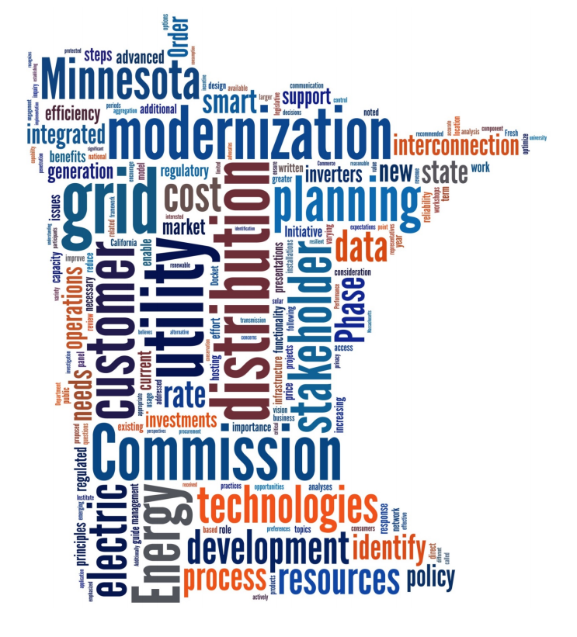

NASUCA
FERC Order 2222: State Implications

Slide 2
Disclaimer
The ideas expressed are the views of the presenter, and not the Minnesota Public Utilities Commission or the Organization of MISO States.

Slide 3
Order 2222:
State Implications and Actions
Direct Order Needs RTO/ISO Stakeholder Process Participation Development of RTO/ISO tariffs through state representation and regional entity participation RTO/ISO Coordination Framework Creation | State Coordination Role (Listed in 2222) Interconnection Agreements and Rules Local rules for distribution system reliability and safety Data sharing requirements (RTO, DERA) Metering and telemetry requirements Review of DU review of DER participation in DERA (60 days) Rules for multi-use applications Resolving disputes
State Enabling Actions Integrated Distribution System Planning Interconnection Standards; IEEE1547-2018 Consumer/DER Data Access Grid Data and Hosting Capacity Metering and Telemetry Alignment Evaluation of Retail Program Services Grid Modernization Investments Retail Product Definition Dispute Resolution Process (Consumer Affairs) | Broad Implications (Other) Consistency with State Energy Action Plans / State Policy Proactive or Reactive Involvement Demand Response + FERC Order 719 Status Grid Modernization Investments Review Wholesale Distribution System Charges Enabling Grid Technology Cost Allocations State Law Changes? (DERA-registration, data collection from unreg entities (coops/munis), utility definition)

Slide 4
Order 2222:
State Implications and Actions
Direct Order Needs RTO/ISO Stakeholder Process Participation Development of RTO/ISO tariffs through state representation and regional entity participation RTO/ISO Coordination Framework Creation | State Coordination Role (Listed in 2222) Interconnection Agreements and Rules Local rules for distribution system reliability and safety Data sharing requirements (RTO, DERA) Metering and telemetry requirements Review of DU review of DER participation in DERA (60 days) Rules for multi-use applications Resolving disputes
State Enabling Actions Integrated Distribution System Planning Interconnection Standards; IEEE1547-2018 Consumer/DER Data Access Grid Data and Hosting Capacity Metering and Telemetry Alignment Evaluation of Retail Program Services Grid Modernization Investments Retail Product Definition Dispute Resolution Process (Consumer Affairs) | Broad Implications (Other) Consistency with State Energy Action Plans / State Policy Proactive or Reactive Involvement Demand Response + FERC Order 719 Status Grid Modernization Investments Review Wholesale Distribution System Charges Enabling Grid Technology Cost Allocations State Law Changes? (DERA-registration, data collection from unreg entities (coops/munis), utility definition)

Slide 5
Order 2222:
State Implications and Actions
Direct Order Needs RTO/ISO Stakeholder Process Participation Development of RTO/ISO tariffs through state representation and regional entity participation RTO/ISO Coordination Framework Creation | State Coordination Role (Listed in 2222) Interconnection Agreements and Rules Local rules for distribution system reliability and safety Data sharing requirements (RTO, DERA) Metering and telemetry requirements Review of DU review of DER participation in DERA (60 days) Rules for multi-use applications Resolving disputes
State Enabling Actions Integrated Distribution System Planning Interconnection Standards; IEEE1547-2018 Consumer/DER Data Access Grid Data and Hosting Capacity Metering and Telemetry Alignment Evaluation of Retail Program Services Grid Modernization Investments Retail Product Definition Dispute Resolution Process (Consumer Affairs) | Broad Implications (Other) Consistency with State Energy Action Plans / State Policy Proactive or Reactive Involvement Demand Response + FERC Order 719 Status Grid Modernization Investments Review Wholesale Distribution System Charges Enabling Grid Technology Cost Allocations State Law Changes? (DERA-registration, data collection from unreg entities (coops/munis), utility definition)

Slide 6
Order 2222:
State Implications and Actions
Direct Order Needs RTO/ISO Stakeholder Process Participation Development of RTO/ISO tariffs through state representation and regional entity participation RTO/ISO Coordination Framework Creation | State Coordination Role (Listed in 2222) Interconnection Agreements and Rules Local rules for distribution system reliability and safety Data sharing requirements (RTO, DERA) Metering and telemetry requirements Review of DU review of DER participation in DERA (60 days) Rules for multi-use applications Resolving disputes
State Enabling Actions Integrated Distribution System Planning Interconnection Standards; IEEE1547-2018 Consumer/DER Data Access Grid Data and Hosting Capacity Metering and Telemetry Alignment Evaluation of Retail Program Services Grid Modernization Investments Retail Product Definition Dispute Resolution Process (Consumer Affairs) | Broad Implications (Other) Consistency with State Energy Action Plans / State Policy Proactive or Reactive Involvement Demand Response + FERC Order 719 Status Grid Modernization Investments Review Wholesale Distribution System Charges Enabling Grid Technology Cost Allocations State Law Changes? (DERA-registration, data collection from unreg entities (coops/munis), utility definition)

Slide 7
Order 2222:
State Implications and Actions
Direct Order Needs RTO/ISO Stakeholder Process Participation Development of RTO/ISO tariffs through state representation and regional entity participation RTO/ISO Coordination Framework Creation | State Coordination Role (Listed in 2222) Interconnection Agreements and Rules Local rules for distribution system reliability and safety Data sharing requirements (RTO, DERA) Metering and telemetry requirements Review of DU review of DER participation in DERA (60 days) Rules for multi-use applications Resolving disputes
State Enabling Actions Integrated Distribution System Planning Interconnection Standards; IEEE1547-2018 Consumer/DER Data Access Grid Data and Hosting Capacity Metering and Telemetry Alignment Evaluation of Retail Program Services Grid Modernization Investments Retail Product Definition Dispute Resolution Process (Consumer Affairs) | Broad Implications (Other) Consistency with State Energy Action Plans / State Policy Proactive or Reactive Involvement Demand Response + FERC Order 719 Status Grid Modernization Investments Review Wholesale Distribution System Charges Enabling Grid Technology Cost Allocations State Law Changes? (DERA-registration, data collection from unreg entities (coops/munis), utility definition)

Slide 8
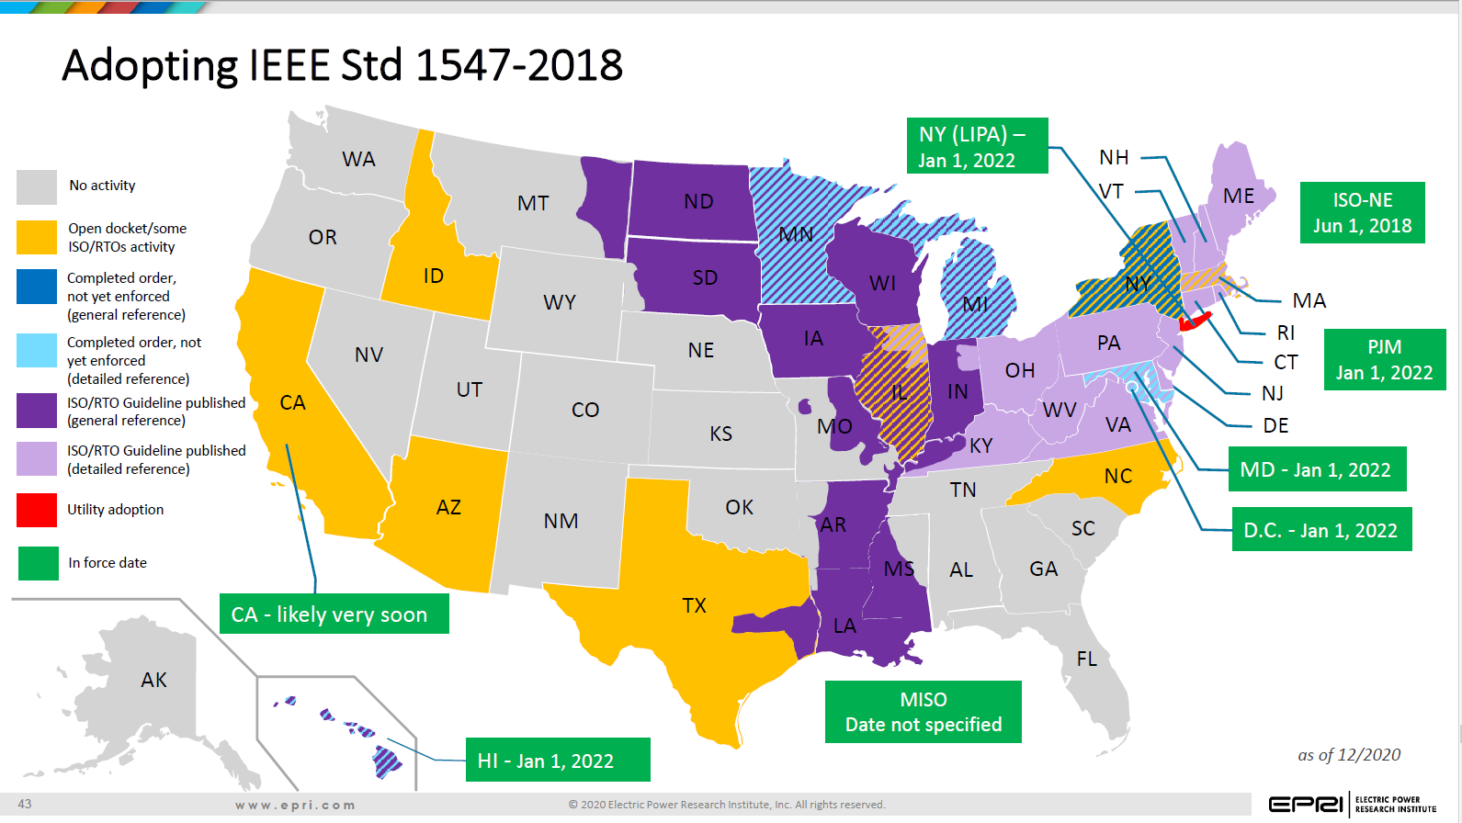
Resources

Slide 9

Order 2222 ‘Lens’
Rate Case Distribution System Investments
Performance Based Metrics
Minn. 216B.16
Retail Program Offerings
Solar Gardens
Interconnection Disputes
State Distribution
System Planning
MN PUC Order 15-556, 18-251
CCOS Allocations
Service Quality
PPA Review
Value of Solar
Minn. Stat. 216B.164
Load Flexibility
Pilots
Non-Traditional
Alternatives Analysis
Interconnection
Standards Update
Minn. Stat. 216B.1611
EV Pilots
Advanced Metering
Infrastructure
Utility Managed
Third Party Suppliers
Non-Wires Alternatives
Integrated Resource Planning
Hosting Capacity
Analysis
Minn. Stat. 216B.2425
FERC Order 2222
Customer Energy
Usage Data
DG Preferred Resource
Grid Modernization
and Investments
Minn. Stat. 216B.2425
Grid-Interactive Buildings
Home Area
Energy Networks
Data Privacy
Affiliated Interest Utility Investments
Grid Data Access
Fuel Clause Review – RTO Pass Through Costs
Community-Based
Solar

Slide 10
What do I do now?
Short Term:
- Participate and monitor the RTO/ISO Order 2222 Tariff Development
Use Order 2222 lens (retail programs, investment requests, utility service bounds)
Adopt IEEE 1547-2018, update interconnection standards (create nimble process)
Educate staff on grid needs, grid modernization, and Order 2222
Consider/Create Distribution System Planning
Evaluate Existing Dispute Resolution Staff and Processes
Review Laws and Regulations (Legislative Needs?)
Monitor Your RTO Order 2222 Implementation Timeline

Slide 11
Questions:
Tricia DeBleeckere
Tricia.DeBleeckere@state.mn.us
612-270-3086

