Slide 1

The PBR Challenge for
US Consumer Advocates
Mark Newton Lowry, PhD
President, Pacific Economics Group Research LLC 44 East Mifflin St. Madison WI
NASUCA Mid-Year Meeting
June 15, 2021

Slide 2
Introduction
Performance-based regulation (“PBR”) and other alternatives to traditional cost of service regulation (“COSR”), collectively called “Altreg”, are being considered in many US jurisdictions today
This presentation briefly discusses
  Forces driving Altreg
  PBR and other Altreg options
  PBR challenges and opportunities for consumer advocates

Slide 3

The Age of Altreg
Cost
Revenue

Slide 4
What’s Driving Altreg?
COSR works best under favorable business conditions that make rate cases less frequent. Infrequent rate cases…
  strengthen utility cost performance incentives
  reduce regulatory cost
Business conditions are less favorable today than in COSR’s “golden age”
  Load growth much slower
  Some utilities nonetheless need high capital spending to modernize infrastructure and increase resiliency and/or reliance on clean energy sources
  >>> Cost tends is grow faster than revenue
  Many generic issues to consider (e.g. rate designs and system planning)
Under COSR, these conditions lead to frequent rate cases, weak cost containment incentives, and high regulatory cost
As well, utilities are financially insulated from environmental damage that they cause
Notes:
4

Slide 5
Altreg Options
COSR limitations have spurred development of (“Altreg”) options
Utilities care mainly about attrition and propose…
  higher fixed charges
  additional cost trackers
  (Cost of service) formula rate plans
  Essentially comprehensive cost trackers
  Used by the FERC and, for retail services, in some southeastern and Exelon states (e.g., AR, AL, MS, LA, IL, MD, DC)
Notes:
5

Slide 6
The PBR Alternative
PBR: Altreg approaches intended to encourage better performance through stronger incentives (aka “incentive regulation”)
4 well-established approaches:
Performance Metrics measure performance in targeted areas
Revenue Decoupling reduces utility resistance to DSM, DG, and high usage charges
Special Incentives for Underused Inputs (e.g. Pilot programs and DSM cost trackers)
Multiyear Rate Plans (“MRPs”)

Slide 7
Multiyear Rate Plans
Key Components
Reduced rate case frequency (e.g., 4 or 5 year cycle)
Precedents
Popular in Great Britain, Canada, and Australia
Attrition relief mechanism (“ARM”) automatically escalates rates or revenue but is not linked to utility’s actual costs
Used in diverse American states (e.g. California, New York, and Florida)
Mounting interest in other states (e.g. Washington and North Carolina)
>>> Stronger cost containment incentives
>>> More efficient regulation
Ontario is a North American PBR leader

Slide 8
Basic PBR Approaches Often Combined
Special Incentives for Underused Inputs
Multiyear
Rate Plans
Performance Metrics
Revenue
Decoupling

Slide 9
MRP Pros and Cons
  Pro
  MRPs do streamline regulation and have sometimes sparked better performance
  Utilities assume some risk
  MRPs sometimes include productivity growth targets and/or statistical benchmarking of reliability and cost
  >>> Refreshing emphasis on utility performance
  MRPs often initiated by legislators and regulators, not utilities

Slide 10
  MRP Con
  Utilities can and have played strategic games in MRP ratemaking
  US regulatory staff and consumer groups are underfunded relative to foreign (e.g. Canadian) counterparts
  Consumer advocates have lost some PBR battles (e.g. MA) but also won some (e.g. HI)
  Confusion is commonplace in legislative and regulatory undertakings to consider PBR
  Consultants are often not PBR experts.
  Some consultants will “say anything” to advance their clients’ interests
  Misconceptions that result can lead to surprising outcomes
  MD and DC have recently approved “multiyear rate plans” that are really formula rates due to “reconciliation mechanisms”
  IL is on the verge of doing the same thing

Slide 11
Conclusions
  Altreg is a reflection of environmental concerns and unfavorable business conditions
  Environmental groups are major Altreg players
  Altreg options are often misunderstood
  Amongst the Altreg approaches, PBR has the best shot at helping consumers
  PBR includes multiyear rate plans and decoupling, not just metrics
  Consumer advocates should keep an open mind about PBR
  Consider going out the PBR learning curve and becoming forceful, persuasive practitioners

Slide 12

Appendix

Slide 13
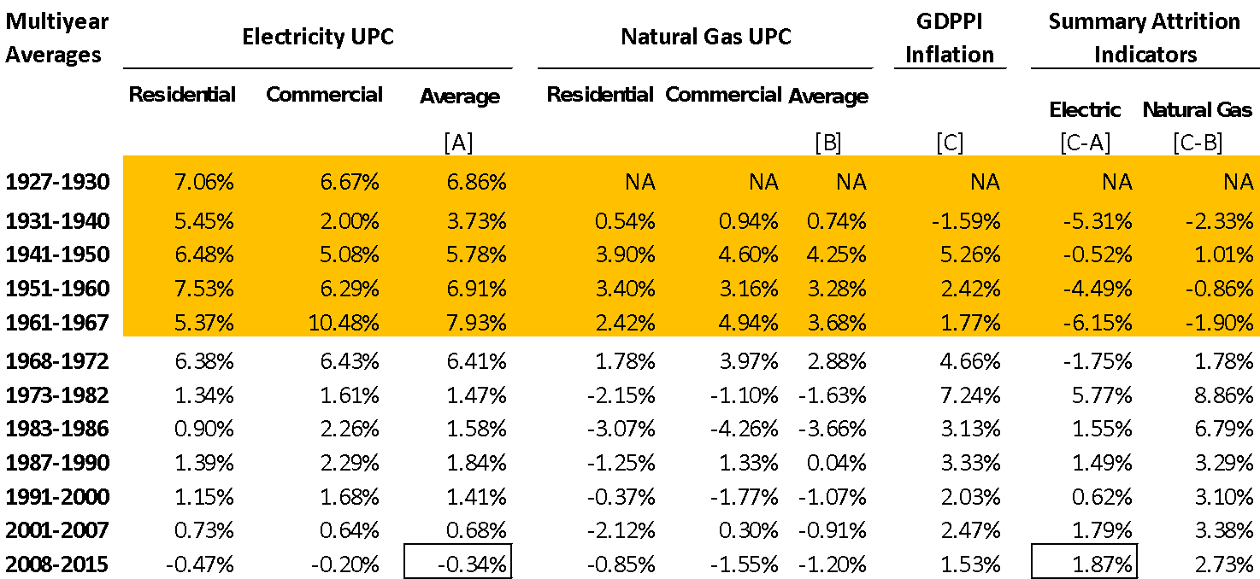
Indicators of Energy Utility Attrition 1931-2015¹
>>> Key business conditions are on balance much less favorable today than in COSR’s “golden age” when it became a tradition
¹Colorado Public Utilities Commission, Proceeding 17AL-0649E, Direct Testimony of Mark N. Lowry on Behalf of Public Service Company of Colorado, Hearing Exhibit 105, October 3, 2017, page 29.

Slide 14
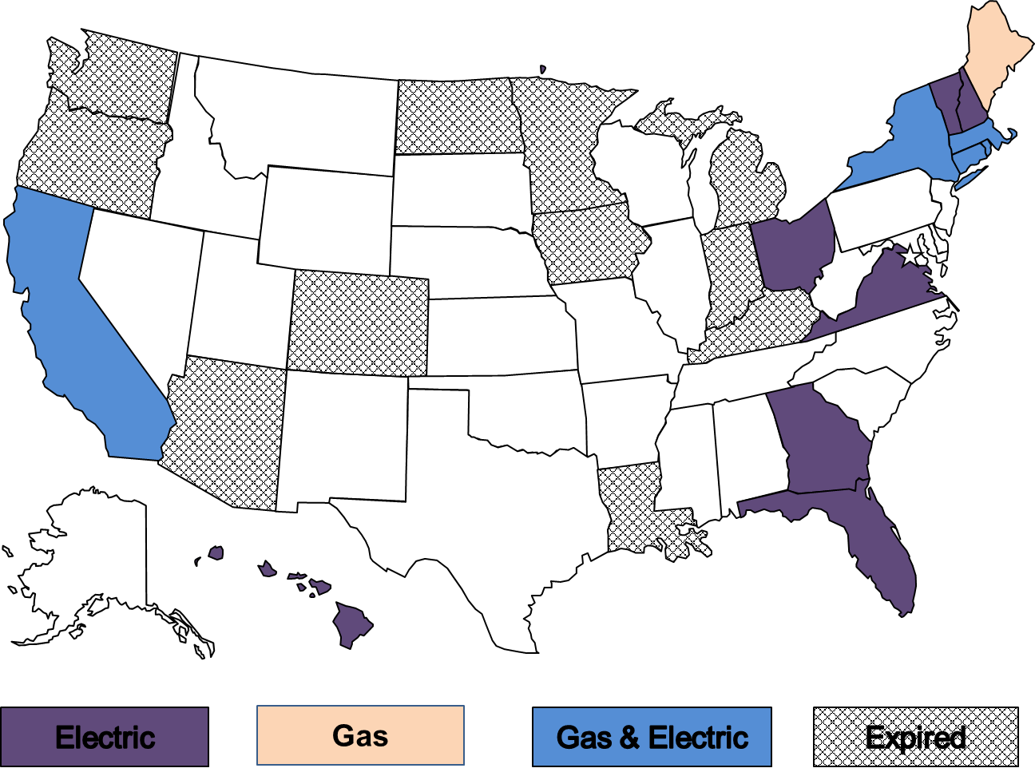
MRP Precedents: United States
MRPs are a common form of Altreg in U.S.
Popular for vertically integrated electric utilities (e.g., Hawaii)
Renewed popularity for power distributors (e.g., New England)

Slide 15
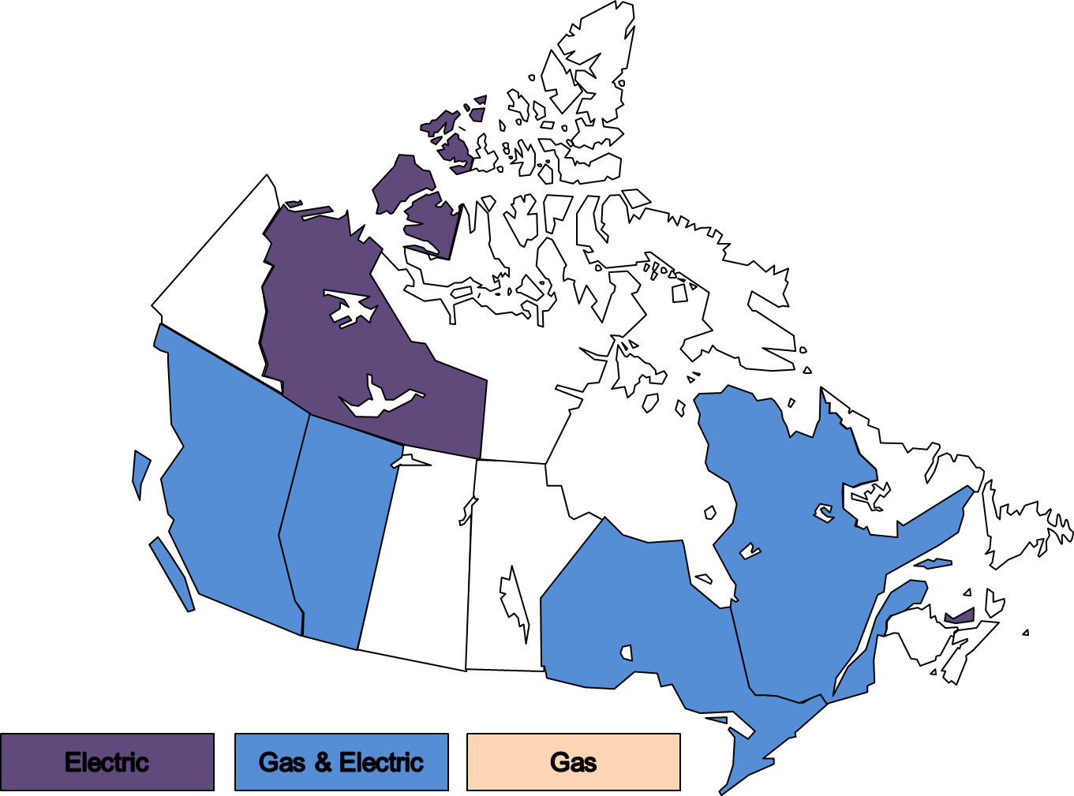
MRP Precedents: Canada
MRPs are the norm for Canadian gas & electric power distributors
Impetus has come mainly from policymakers

Slide 16
MRP Case Study: Central Maine Power
Attrition Relief Mechanism:
  growth Rates = growth GDPPI – X (X=1%)
Capital Cost Tracker: Automated metering infrastructure
Earning Sharing: Asymmetric sharing of surplus earnings
Plan term: 5 years (2009-13)
Service Quality: Multi-indicator penalty mechanism
Marketing Flexibility: Light-handed regulation of optional targeted rate schedules and rate discounts
Reference: Maine Public Utilities Commission, “ARP 2008 Settlement,” June 2008

Slide 17
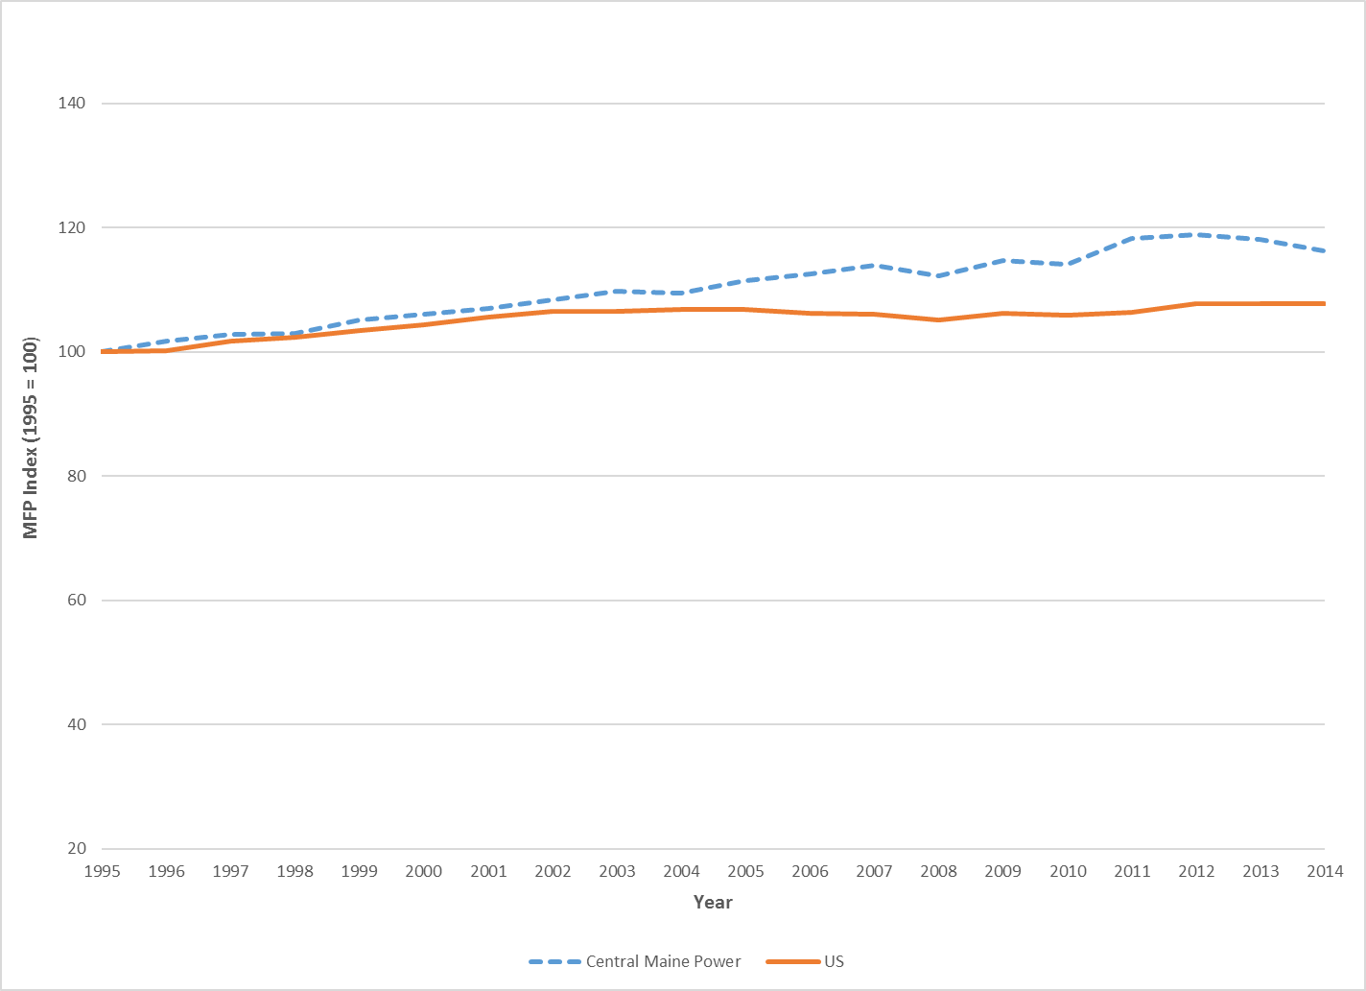
Multifactor Productivity Trend of CMP Under MRPs
MRPs have improved utility performance
But some plan provisions (e.g., earnings sharing & capital cost trackers) weaken incentives

Slide 18
ARM Design Options
ARM design is biggest issue in most MRP proceedings
Several well-established approaches
  Indexing
  e.g., growth Revenue = Inflation – X + growth Customers
  Forecasting
  Hybrid
X factor controversies in US and Canada
Notes:
18

Slide 19
Revenue Decoupling
Decoupling Basics
Tracker and rider cause actual revenue to track allowed revenue closely
Thus, revenue (and earnings) are “decoupled” from UPC
Revenue adjustment mechanism escalates allowed revenue (e.g., for customer growth)
Decoupling Advantages
  Eliminates “lost margin” disincentive for utility to embrace DSM and DG
  Rate designs that encourage efficient DSM and DG are less risky
  No need for high fixed charges that many (e.g., Wisconsin) utilities favor
  Reduces rate case frequency by targeting an attrition problem

Slide 20
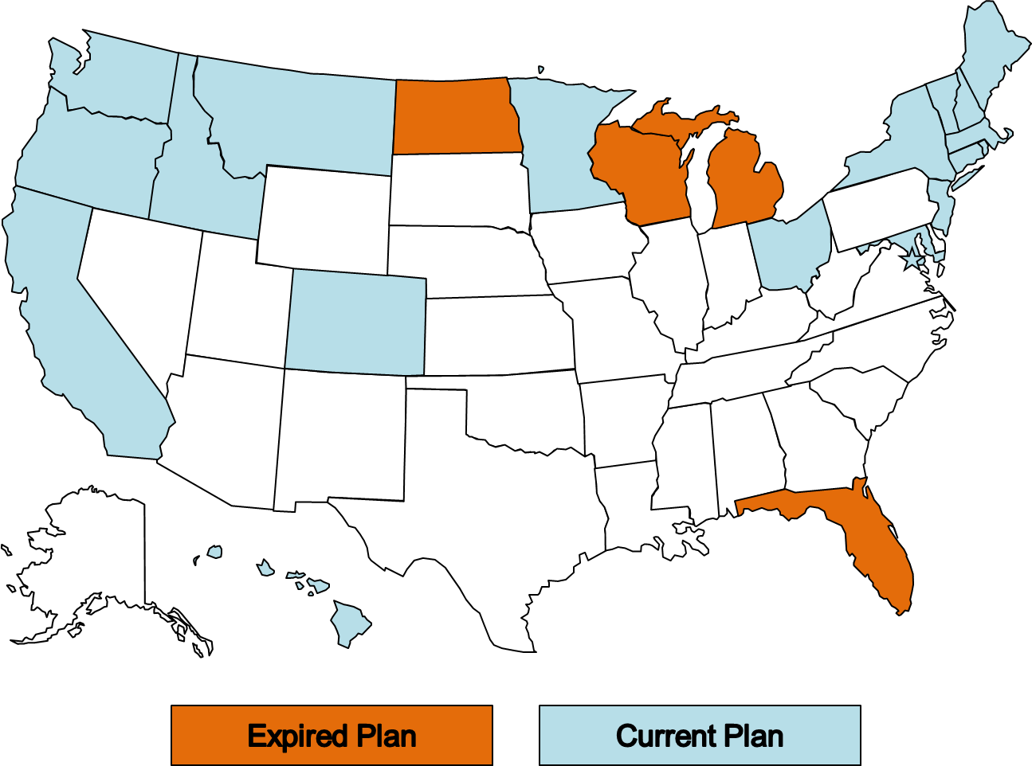
Revenue Decoupling Precedents: Electric

Slide 21
Special Incentives for Underused Inputs
The Basic Idea
Utilities can be reluctant to use certain inputs (e.g., substitutes for capex) or embrace new ways of doing things
Targeted inducements for such actions are available
Tools
  Trackers and riders for costs of underused inputs
  (e.g., DSM and purchased power expenses)
  Capitalize operation & maintenance expenses and add ROE premium
  Prior approval and pilot programs for risky but promising initiatives
Downside
  Cost trackers are a crude tool that can give rise to excessive costs
  (e.g., many utilities have made imprudent purchased power commitments)

Slide 22
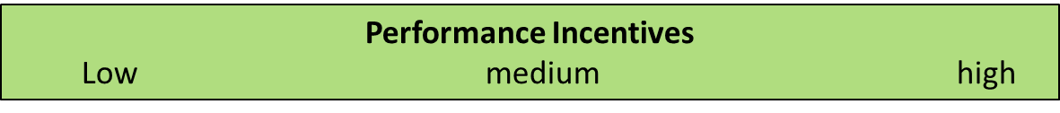
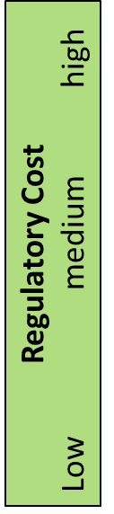
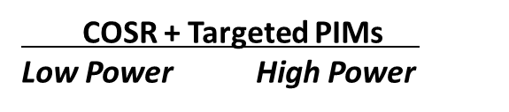
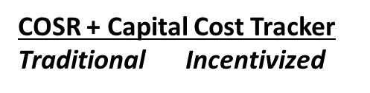
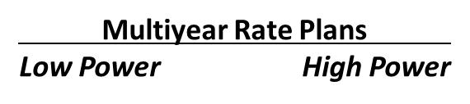
Key Attributes of Altreg Alternatives
COSR +
Planning
COSR
COSR + Decoupling
Formula Rates

Slide 23
Performance Metrics
Performance metrics quantify utility activities in key performance areas
Several potential uses
PIMs strengthen incentives in targeted areas by linking revenue to performance
Performance metric systems can have different approaches for different metrics
“Scorecards” summarize utility performance for public
Monitoring Only
Monitoring with Target
Performance Incentive Mechanisms (PIMs)

Slide 24
What do PIMs Target?
PIMs most commonly target service quality and energy conservation
(e.g., positive incentive to embrace conservation)
Need for new performance metrics and incentive mechanisms is focus of recent “utility of the future” proceedings
Peak load management
  System load peak
  “Non-wire alternatives” to local grid investments
Utilization of advanced metering infrastructure capabilities
Quality of service to DG customers
Electric vehicles

Slide 25
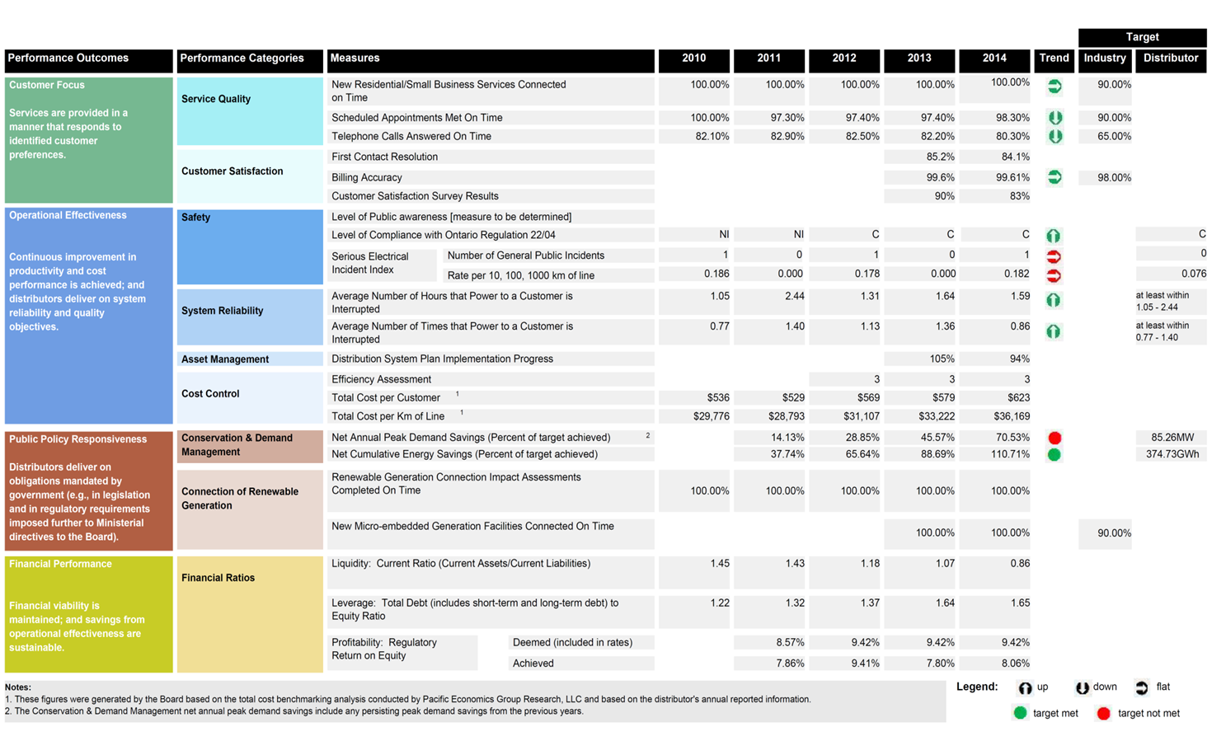
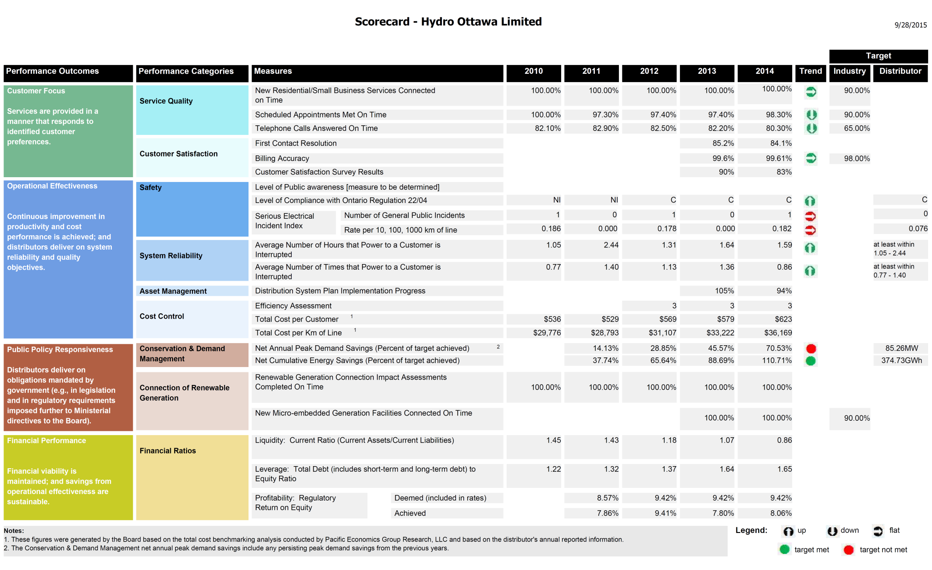
Ontario Scorecard Metrics

Slide 26
Ontario Scorecard Categories (continued)

Slide 27
Cost Performance PIMs
  Cost performance PIMs have the general form
  Award/Penalty = $ x (Cost Metric^{Actual} / Cost Metric^{Benchmark} )
  Benchmarks are often based on statistics (e.g., average value of metric for a utility peer group)
  Statistical Benchmarking Approaches to benchmarking that use statistics

Slide 28
Econometric Benchmarking
Basic steps…
Develop mathematical model of relationship between cost and cost drivers
Estimate model parameters using historical utility operating data
Fit model with parameter estimates (a₀ , a₂, …) & utility values for business condition variables
ln Cost_{Bench} = a₀ + a₁ x ln Input Prices^{Western}
+ a₂ x ln Customers^{Western} + a₃ x ln Line Miles^{Western} + …
Compare benchmark to utility’s actual value
Performance = Cost_{Actual}/Cost_{Bench}
Notes:
28

Slide 29

Illustrative Econometric Cost Model Used in Regulation
REFERENCE:
Public Utilities Commission of Colorado, D-17AL-0649E, Testimony of Mark N Lowry for Public Service of Colorado, October 3, 2017. Model developed by PEG Research LLC

Slide 30
Benchmarking in Regulation
Regulators in some jurisdictions do their own cost benchmarking
Australia O&M & capex
  Ontario Total cost
  GB “Totex” (O&M & capex)
e.g., Ontario Energy Board
60+ Ontario power distributors operate under multiyear rate plans
Board benchmarks their total cost annually using econometric model
Basis for “stretch factors” in price cap indexes w/ Inflation – X formulas
Distributors must use the model to benchmark their proposed forward test year revenue requirements in rate cases
OEB is now developing granular benchmarking capability
Notes:
30

Slide 31
Roles for PBR Tools
  When PBR tools are used in concert each has a role
  PBR Tools Roles
  Multiyear Rate Plans Strengthen general cost containment incentives
  Streamline regulation
  Revenue Decoupling Removes disincentives to embrace DSM, DG, and innovative pricing
  Special Incentives for Encourages use of these inputs
  Underused Inputs
  PIMs Shore up weak spots in incentive structure

Slide 32
Formula Rates
Basic Idea
Revenue requirement adjusted annually to reflect pro forma cost of service --- “cost of service formula”
Retail variant: reset rates automatically to achieve target ROE when actual (or forecasted) ROE differs materially
Scope and duration of prudence reviews reduced
Supplemental “bells & whistles” may strengthen incentives and add a PBR flavor
  SQ PIMs
  growth Revenue^{O&M} < Growth CPI+ 0.5%

Slide 33
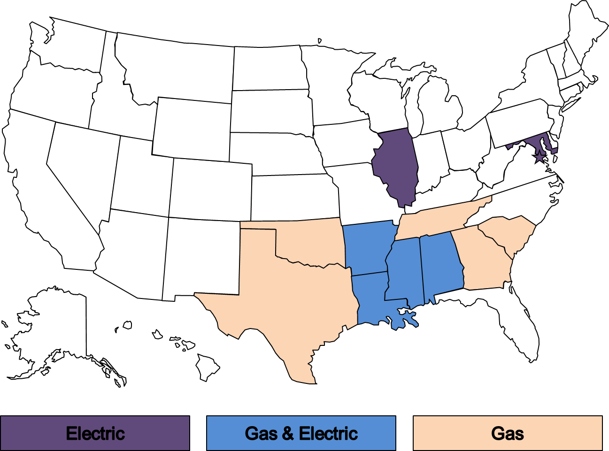
Formula Rate Precedents

Slide 34
Bibliography
Lowry, Mark Newton and David Hovde, “Escalating Power Distributor O&M Revenue,” Electricity Journal, forthcoming, July 2021.
Lowry, Mark Newton and Matthew Makos, “PBR and Climate Change,” Climate and Energy, forthcoming, July 2021.
Lowry, Mark Newton, “Four Common Myths About Performance-based Regulation,” Utility Dive, April 27, 2021.
Lowry, Mark Newton and Matthew Makos, “Revenue Decoupling at 40, Venerable PBR Tool Goes National,” Public Utilities Fortnightly, April 2021.
Lowry, Mark Newton, Matthew Makos, Jeff Deason, and Lisa Schwartz, “State Performance-Based Regulation Using Multiyear Rate Plans for U.S. Electric Utilities,” for Lawrence Berkeley National Laboratory, Grid Modernization Laboratory Consortium, U.S. Department of Energy, July 2017.
Lowry, Mark Newton and Tim Woolf, “Performance-Based Regulation in a High Distributed Energy Resources Future,” for Lawrence Berkeley National Laboratory, Future Electric Utility Regulation series, January 2016.

Slide 35
About Dr. Lowry
  President, Pacific Economics Group Research LLC
  Active in PBR field since 1989
  Specialties: regulatory strategy, PBR mechanism design, input price and productivity research, statistical benchmarking, expert witness testimony
  Former Penn State University energy economics professor
  PhD Applied Economics, University of Wisconsin
Pacific Economics Group Research LLC
44 East Mifflin St.
Madison, Wisconsin USA
608-257-1522 ext. 23
mnlowry@pacificeconomicsgroup.com
www.pacificeconomicsgroup.com

