Slide 1
Building gas system resilience Jeff Stein Senior Policy Advisor Policy, Economics, and Regulatory Affairs
June 14th, 2021

Slide 2
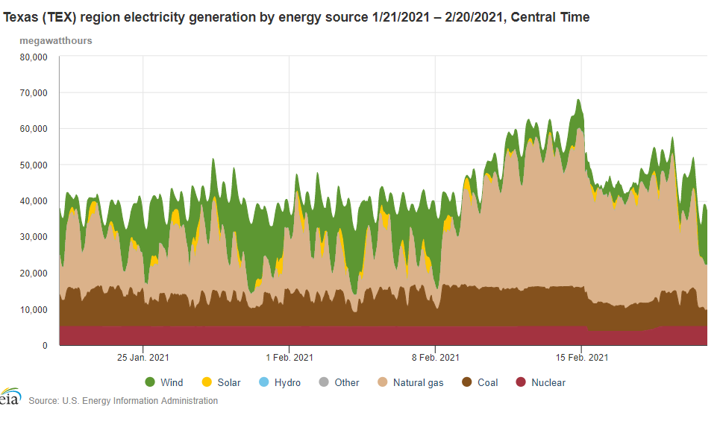
COLDEST
Total Demand
Current production capacity is 0.6 million metric tons/year
Production capacity is expected to grow significantly in the next decade
Platts estimates by 2028 production will reach 3.3 million mt/yr
Normal conditions, with gas tracking wind….
COLDER
~20 GW
COLD
Generation
Narrowly Avoided Catastrophe
Massive
Outages
Sun - Thurs

Slide 3
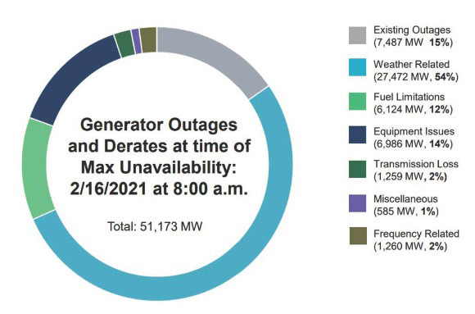

Slide 4
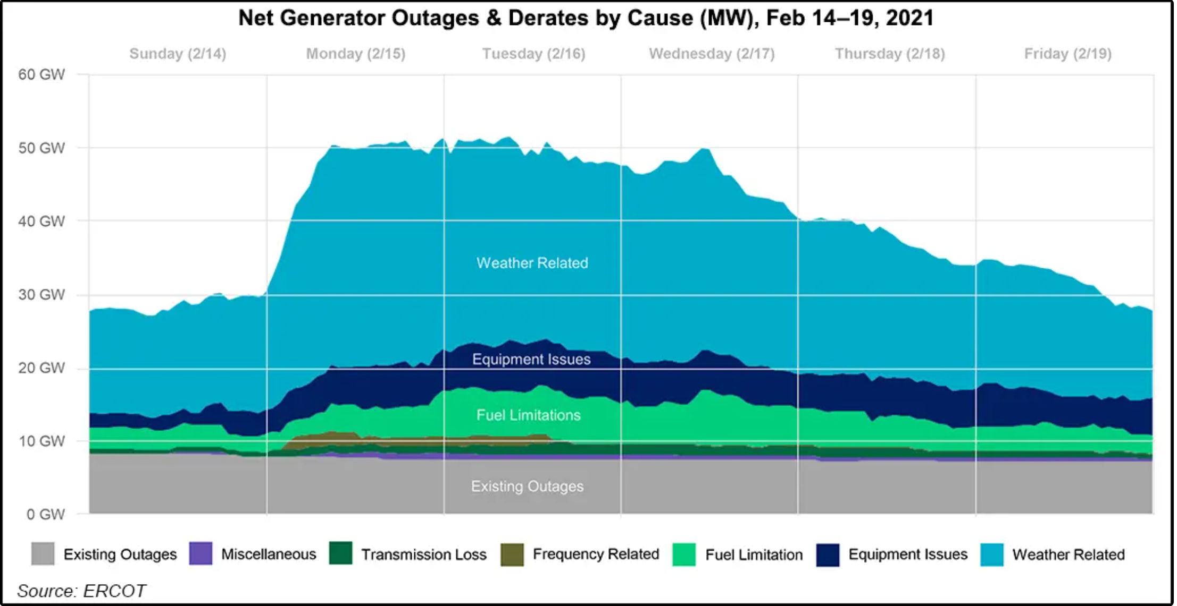

Slide 5
Fuel delivery issues
Estimated to have contributed to about 10% of outages
Fuel delivery issues had several causes
Main challenges in the upstream, per a survey commissioned by TXOGA, included loss of power (65%), wellhead and equipment freeze-offs (13%) and not being able to get production out due to issues with third-party facilities (8.7%).
Midstream operators faced similar challenges—80% cited power outages as a main cause of outages.

Slide 6
Some next steps to address resilience
Texas legislature
SB3—requires upgrades for power generators and transmission lines to make them better withstand extreme weather.
New legislation signed into law to ban wholesale electricity plans.
Federal/national efforts
FERC and NERC are conducting a joint inquiry on events in South and Central states.
Other regions
MISO report in June 2021 recommends Resource Adequacy evolution.

Slide 7
Reliabiltiy and Resilience with lower emissions fuels
Continued replacement of coal with natural gas--including innovative lower emissions plants.
Deployment of low-carbon hydrogen and other lower-emissions fuels will require overcoming physical and regulatory barriers related to infrastructure deployment.
API and member companies support policies to advance the global low-carbon hydrogen economy.

