Slide 1
FERC Order No. 2222: Opening the Door to DERs in Wholesale Markets
Jeff Dennis
General Counsel and Managing Director
Advanced Energy Economy
June 15, 2021

Slide 2
About Advanced Energy Economy (AEE)
AEE is a national association of businesses that are making the energy we use secure, clean, and affordable.
AEE is the only industry association in the United States that represents the full range of advanced energy technologies and services, both grid-scale and distributed. Advanced energy includes energy efficiency, demand response, energy storage, wind, solar, hydro, nuclear, electric vehicles, and more.
AEE also supports the work of the Advanced Energy Buyers Group (”AEBG”), a coalition of large buyers of advanced energy technologies to meet sustainability goals.
AEE pursues policy transformation in the states and in wholesale power markets that expand market opportunities for advanced energy technologies and lay the foundation for a 100 percent clean advanced energy future.

Slide 3
Order No. 2222 Overview: Basic Framework
What it does: Order No. 2222 requires market operators to ensure that aggregations of distributed energy resources (DERs) have one or more pathways to provide all the wholesale services they are technically capable of providing.
FERC found this was necessary to improve competition and ensure “just and reasonable” rates.
Technologies covered: FERC defines DERs broadly to include “any resource located on the distribution system, any subsystem thereof or behind a customer meter,” and says that such resources may include (but are not limited to) electric storage resources, distributed generation, demand response, energy efficiency, thermal storage, and electric vehicles and their supply equipment.
Who it applies to: All RTOs/ISOs under FERC jurisdiction must amend existing participation models or create new ones to enable participation by DER aggregations.
Notes:
Explain “pathways” – if you are a generator, there are a collection of market rules that provide a roadmap for you to participate. Same for DR, and for storage. This requires that DER aggregations have a roadmap too.
FERC noted that without such a roadmap, these resources cannot participate, because they are too small or their unique technical and operational characteristics aren’t accommodated. This limits competition, which can cause unjust and unreasonable wholesale rates.
Does not apply to ERCOT.

Slide 4
Order No. 2222 Overview: Key Compliance Requirements
Parameter(s) | Key Requirement(s)
Eligibility of DER aggregators/DER types | DER aggregators must be an eligible market participant; RTOs/ISOs must allow all technology types and multi-technology combinations; rules must prevent “double counting” of services; no state “opt-out” allowed; small utilities are exempt
Geographic scope of aggregation | Encourages broad geographic scope of aggregation, but allows RTOs/ISOs to propose to limit aggregations to a single pricing node
Distribution factors and bidding parameters | Must account for physical and operational characteristics of DER aggregations and ensure they are able to fully offer their aggregations into RTO/ISO markets
Information and data requirements | RTOs/ISOs are required to transparently state the information and data that DER aggregators must provide them about the performance, physical parameters, and components of their aggregations
Metering and telemetry requirements | RTOs/ISOs have flexibility to set these requirements, including whether to require metering and telemetry of individual DERs; must justify why they are necessary and explain why they do not result in undue barriers to participation
Coordination | Requires RTOs/ISOs to establish procedures for coordination between RTOs/ISOs, DER aggregators, distribution utilities, and state and local regulators
Notes:
Rule provides direction to the RTOs/ISOs regarding key parameters that these new participation models, pathways, roadmaps must address to ensure that DER aggregations can compete.
Geographic scope – FERC says as broad as technically feasible
Distribution factors and bidding parameters are some of the detailed input options that DER aggregations must have access to, to facilitate their market participation. “Distribution factors” are the total response expected from a location.
Coordination includes processes for distribution utility review of DERs included in an aggregation to ensure that participation will not threaten distribution safety and reliability; operational coordination, including potential override by a distribution utility; and communications between all of these entities.

Slide 5
Federal and State Regulation of DER Participation in Markets after Order No. 2222
FERC
Terms and conditions of participation in wholesale markets, including who can participate
Rates for some (but not all) wholesale sales from DERs
Rates, terms, and conditions of any transmission or wholesale services provided by DERs
State / Local Regulators
Terms and conditions of retail market service provided by DERs and retail DER programs
Distribution interconnection
Siting of DERs (in some cases)
Distribution system cost recovery
Distribution system operations (including reliability and safety)
State and local regulators retain significant authority to address reliability, safety, and cost impacts on distribution systems of DER participation in wholesale markets, and terms and conditions of retail DER programs (including who participates in those retail programs)
Cannot, however, regulate who can participate in wholesale markets, or how
Requires active coordination of wholesale and retail operations
Notes:
What we’re left with is overlapping complementary jurisdiction, which I would contend is what the FPA envisioned and requires.
Tools: Distribution interconnection to address reliability, and tariff options to recover costs.
Thomas: I don’t want jurisdiction to get in the way of technology advancement; let’s get to a place where resources are chosen based on price and performance.

Slide 6
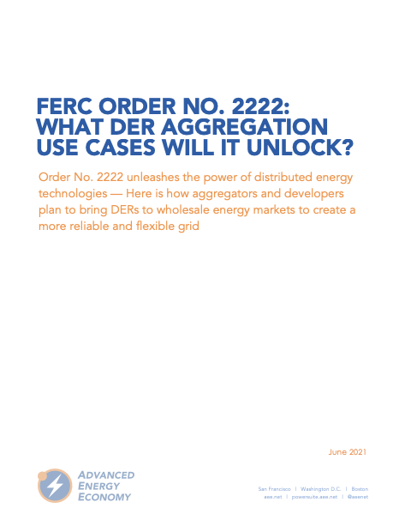
DERs Are an Important Part of the Future Resource Mix
Cumulative distributed energy resource capacity in the United States is projected to grow to 387 gigawatts by 2025
Order No. 2222 gives us the opportunity to make the most of DER investments to benefit consumers and the grid
Recent AEE report illuminates the near-term use cases that DER aggregators expect to pursue under Order No. 2222, the benefits of integrating these uses cases into wholesale markets, and solutions to overcome barriers to participation
Report available at: https://info.aee.net/ferc-order-no.-2222-and-the-use-cases-it-can-unlock
Notes:
In 2019, there were 11 GWs of DERs participating in MISO’s wholesale market, and DERs are expected to increase see https://cdn.misoenergy.org/DER%20Framing%20Report%202019397951.pdf
AEE worked with members to develop this report in response to RTO + state requests who wanted to see what we thought near term opportunities were for order 2222 and the barriers we think 2222 should be addressing.

Slide 7
What DER Aggregations Will Order 2222 Unlock in the Near Term?
Frequently Dispatched DERs, e.g., Electric Buses, Battery storage
Residential Demand Response, e.g., Smart Thermostats and Water Heaters
Residential Behind-the-Meter (BTM) Resources, e.g., Solar, Solar + Storage, Storage, and EV Charging
Front-of-the-Meter (FTM) Distribution-Connected Resources
This is a non-exhaustive list intended to help illuminate considerations that must be taken into account to accommodate a range of DERs.

Slide 8
Benefits of Increased DER Participation in Wholesale Markets
Directly from Order 2222:
Enhanced resilience to infrastructure threats (e.g., weather) through reliance on local DERs
Improved competition and lower wholesale rates, benefitting all ratepayers
Additional supply of services vital for cost-effective decarbonization
Unlocking new revenue streams, lowering costs for developers and customers
Future Opportunities with Increased Collaboration:
Increased visibility of DERs for transmission and distribution grid operators
Enhanced resilience to infrastructure threats (e.g., weather) through reliance on local DERs
Accelerated achievement of state policy goals

Slide 9
Next Steps
Compliance Process:
RTOs/ISOs must make compliance filings with FERC. Stakeholder processes to develop compliance plans are underway
CAISO and NYISO will file in July 2021; MISO and SPP filings due in April 2022; PJM and ISO-NE filings due in February 2022
FERC will accept comments from all interested parties, then issue decisions on compliance plans, which may require RTOs/ISOs to make additional filings
Implementation:
Implementation dates will likely vary by RTO/ISO, and will depend on a number of factors, including alignment with existing markets and needed software upgrades
Additional Proceedings:
Additional clarification and rehearing requests on application of opt out for demand response and other issues now pending (ruling expected this Thursday)
New rulemaking proceeding will consider whether to eliminate the demand response opt out allowed by Order Nos. 719/745

Slide 10
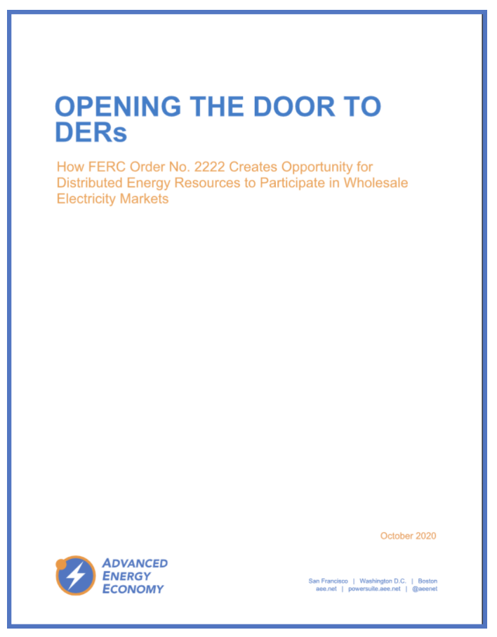
October AEE policy brief explains Order No. 2222
Opening the Door to DERs
How FERC Order No. 2222 Creates Opportunity for Distributed Energy Resources to Participate in Wholesale Electricity Markets
Available at: https://info.aee.net/opening-the-door-to-ders

Slide 11
THANK YOU!
Jeff Dennis
jdennis@aee.net
Twitter: @EnergyLawJeff

