Slide 1

MADISON WATER UTILITY’S
LEAD SERVICE LINE REPLACEMENT
Notes:
Thanks for the introduction.

Slide 2
BACKGROUND
1
Why Lead Service Line Replacement?

Slide 3

About Madison
Notes:
Madison Water Utility was established in 1882. We are a groundwater utility with 23 wells distributed around the City. At the start of the program the City’s population was about 200,000 people.
We are a public water system owned and operated by the City of Madison. Like other utilities in the state, we are regulated and our rates are set by the Public Service Commission of Wisconsin. We’re governed by a resident Water Utility Board, whose members are appointed by the mayor, and this board and is under the general control and supervision of the Madison Common Council which is made up of 20 alders.

Slide 4
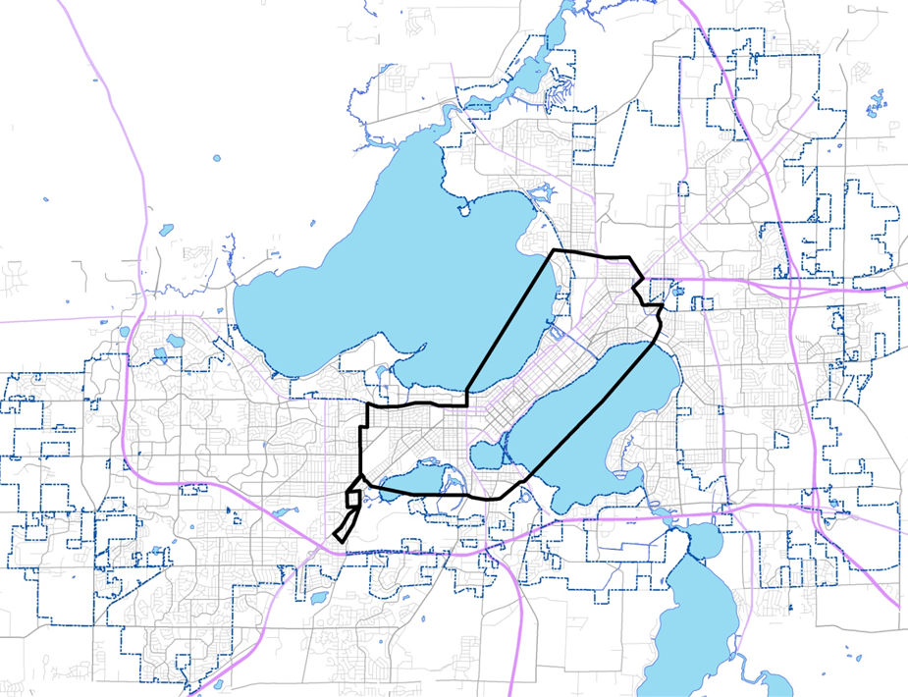
Airport/ Oscar Mayer Plant
Lead Service Area
University
Downtown
Notes:
Lead services were installed until 1927. So from 1882 to 1927, about 11,000 lead services were installed.
Prior to our Lead Service Replacement Program, we didn’t generally keep records of the material used on the property owners’ side of the lateral. But we did often have records noting the material used on our side, so we had a good idea which properties were likely to be impacted by the ordinance.
There was a pretty wide range of property types and values—I’ve tried to note some points of interest on the map. The lead service area included Madison’s “Mansion Hill” neighborhood, student rentals, commercial districts, and modest single-family homes.

Slide 5
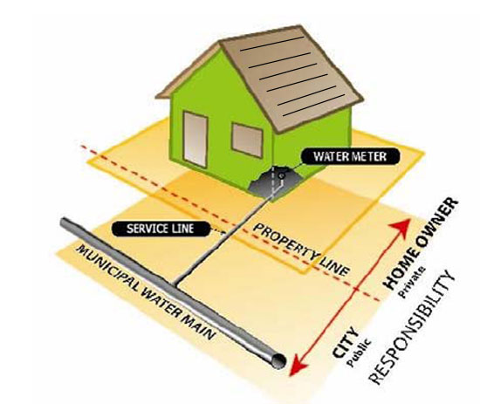
RESPONSIBLITY
Notes:
As in many other communities, there was a portion of the lead service line that was owned and maintained by the utility and there is a portion of the line that is the property owner’s responsibility.

Slide 6
BACKGROUND
1991 – Lead & Copper Rule Enacted
1992 – Initial Monitoring, 90th Percentile = 16 ppb lead
1994 – Corrosion Control Study Initiated
1997 – More Monitoring, 90th Percentile = 16/17 ppb lead
Notes:
The impetus of this was the lead & copper rule. Our initial monitoring showed lead to be a problem, which launched a series of corrosion control studies.

Slide 7
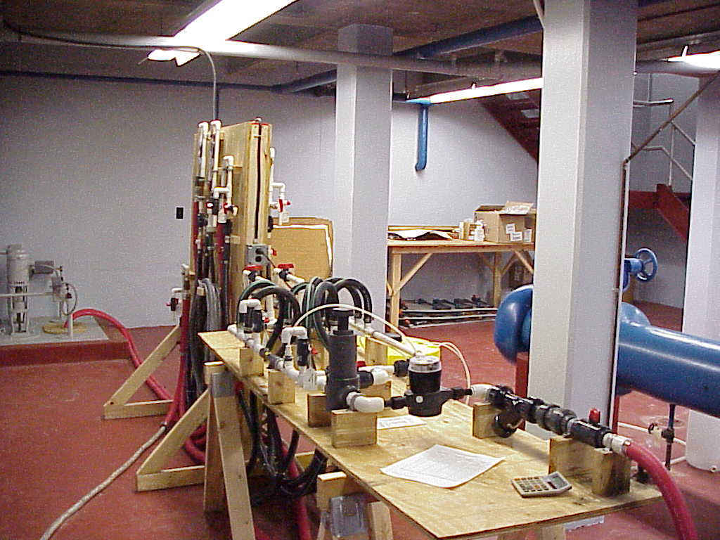
CORROSION CONTROL STUDIES
1994-1998
Standard treatments were ineffective in controlling lead corrosion.
Orthophosphate was shown to reduce lead levels, but would have negatively impacted lakes
Notes:
At the time, the recommended action was corrosion control. Researchers got to work testing different methods—the picture is of a pipe looping test. But standard treatments were ineffective and in one case actually increased lead levels in the water. Eventually orthophosphate was found to reduce lead levels in the drinking water, but if you remember the map of Madison we’re a city that is built around 3 lakes. Phosphorus runoff and nutrient accumulation were already a significant challenge, and adding orthophosphate to the water would have added another potential source. There also would have had environmental impacts downstream as our sewerage district would receive water with higher phosphorus levels.

Slide 8
LEAD SERVICE REPLACEMENT TIMELINE
2000 – Consent Order with DNR
2000- City ordinance enacted
2000-2012- Lead Services Replaced
2011 – Lead Monitoring, 90th Percentile = <5 ppb lead
Notes:
Because of these challenges, the WI Department of Natural Resources agreed that lead service line replacement could be done in lieu of chemical treatment. In 2000, a consent order was signed with them, which required a city ordinance and for all services to be replaced within 10 years. Once the City ordinance was enacted, our lead service replacement program began. Our lead service replacement program took 12 years, and we are now on reduced monitoring for lead & copper.

Slide 9
HOW WE DID IT
2
Flashpoints and lessons learned

Slide 10
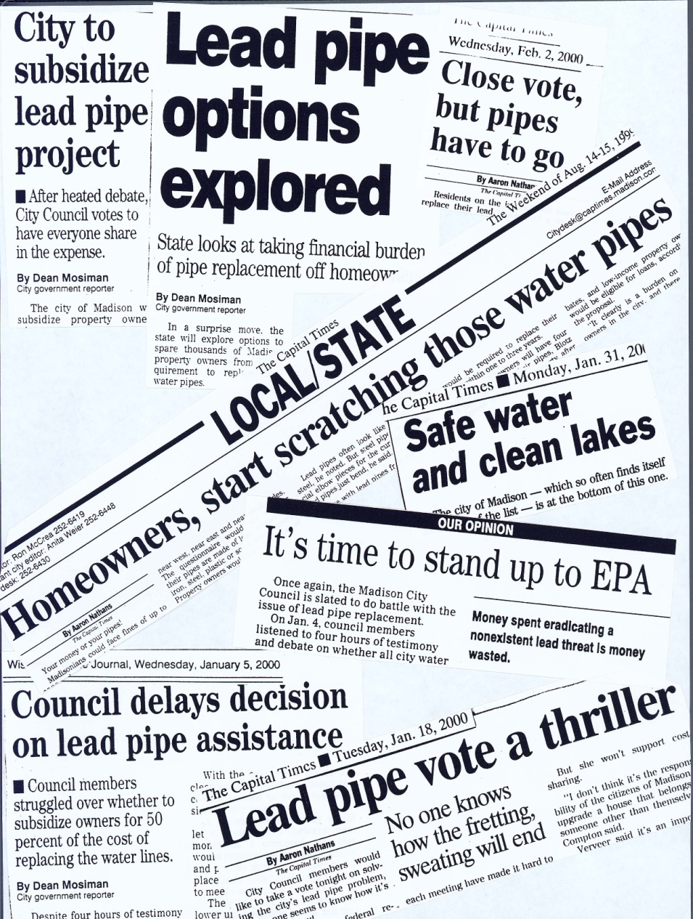
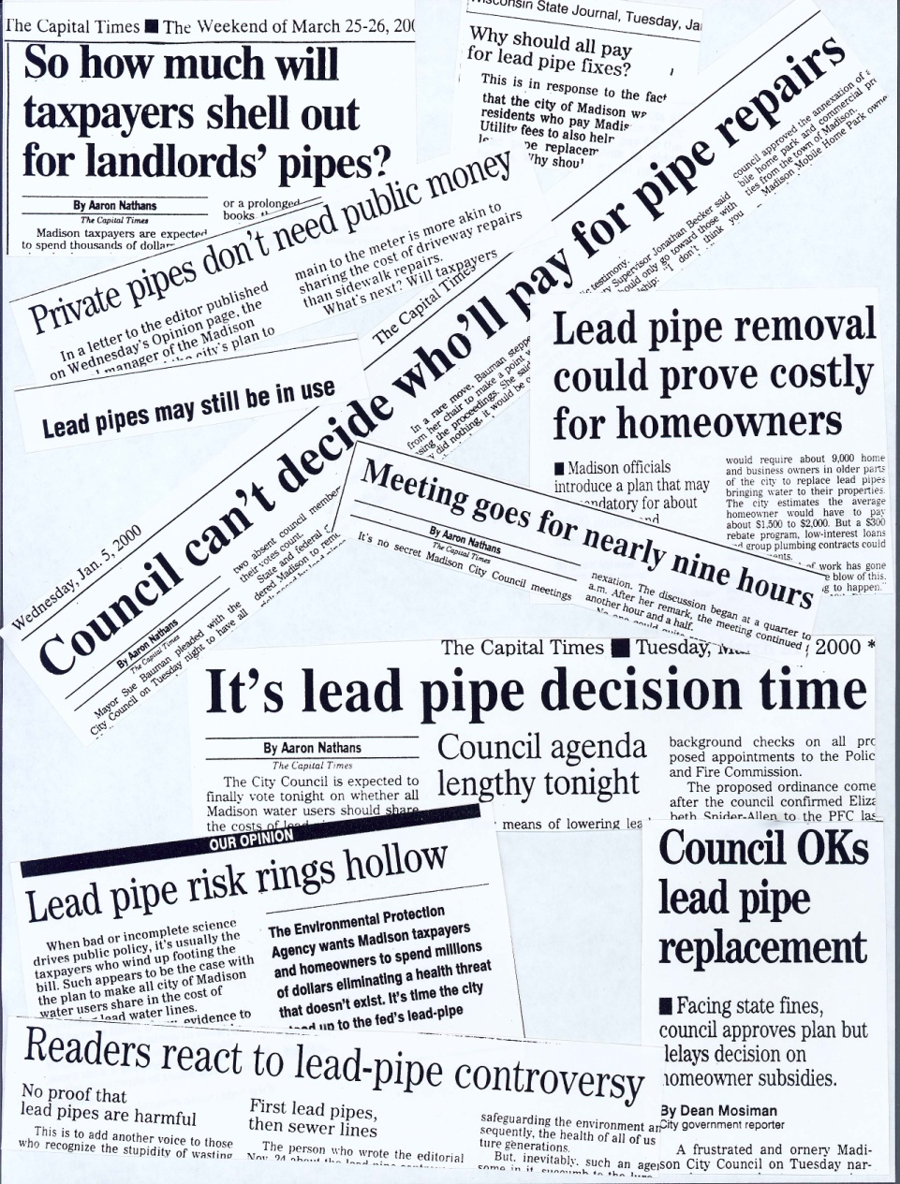
POLITICAL
Notes:
The lead service ordinance barely passed. These old headlines highlight some of the flashpoints and barriers. There was controversy about whether lead water services were even a risk. There was also controversy about who should pay for the replacement of the privately-owned portion of the service. Our utility is regulated by the Public Service Commission of WI and they determined that ratepayer funds could not be used to fund replacements on the private portion of the lead service.

Slide 11
MADISON’S ORDINANCE
Property owners required to complete surveys regarding their service material.
Replacement deadlines timed to coordinate with utility-side replacements and/or street improvement projects
Property-owner replacements reimbursed for half the cost up to $1,000, financing also available
Fine of $50-$1,000/day for noncompliance
Notes:
Ultimately, a compromise was reached. The City would reimburse property owners for half the cost to replace their portion of the service, with a maximum reimbursement (at that time) of $1000.
Since we didn’t have records for privately-owned services, property owners had to complete surveys. Our staff also inspected services during the course of meter replacements and other work.

Slide 12
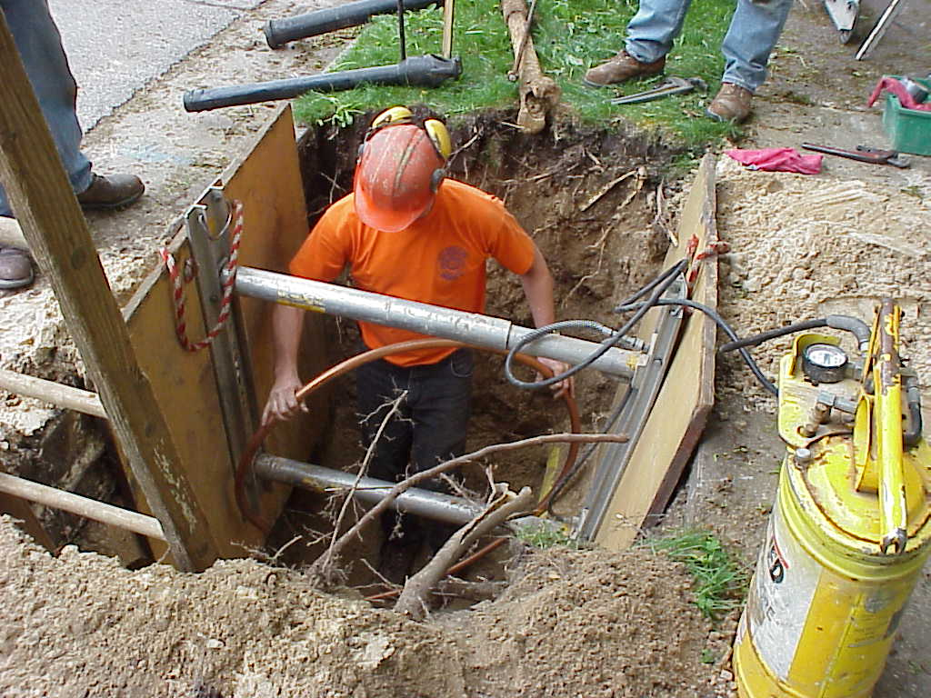
LEAD SERVICE REPLACEMENTS
80% of replacements completed between 2000 and 2006
8,000 services were replaced
5,600 included the privately-owned services
Notes:
The rest were completed during already planned street and main replacement projects between 2007 and 2012.
This is less than the 11,000 I mentioned at the beginning because some lead services were replaced before the program began.
We do still occasionally discover 1-2 lead services a year—usually when a property changes hands. These property owners are still eligible to receive a reimbursement for replacement but the maximum reimbursement was increased to $1500.

Slide 13
PROGRAM COSTS: 2000-2012
$15.5 million: Total cost to utility
$2,315: Avg. cost to replace utility’s portion of a service
$1340: Avg. cost to replace property owner service
$670: Avg. reimbursement to property owners for half the cost

Slide 14
EQUITY
3
Considerations and lessons learned

Slide 15

EQUALITY VS. EQUITY
Notes:
Equity has become a bit of a buzzword and is often used interchangeably with equality.
Our lead replacement program was primarily focused on equality. In some ways that’s a reflection of the times—I know the concept of equity wasn’t on my radar at all 20 years ago. But it’s also an issue within our industry. The reality is that it’s difficult to do something equitable without the people on the lefthand side of this drawing—those who do not need the customized tools—objecting

Slide 16
EQUITY FACTORS
Affordability
Health risks and protective measures
Time poverty
Renters vs. owners
Consumer education and outreach
Notes:
Our program did attempt to address affordability by reimbursing half the cost and providing financing for the other half upon request. This was equal but not equitable. In reality, very few people used the financing, partly because it was complicated and in the end not much better than getting a loan from a bank. Also, reimbursement programs that require people to pay a large amount of money up-front and wait to get funds back disproportionately impact people who have less discretionary funds and access to credit.

Slide 17
More information at madisonwater.org
Or contact me at pholmgren@madisonwater.org

