Slide 1
February 2021 winter storm event
Presentation to NASUCA
Paul Suskie
Executive Vice president & General Counsel
Southwest Power Pool
Updated 5/10/21

Slide 2
2021 winter
Storm grid emergency

Slide 3
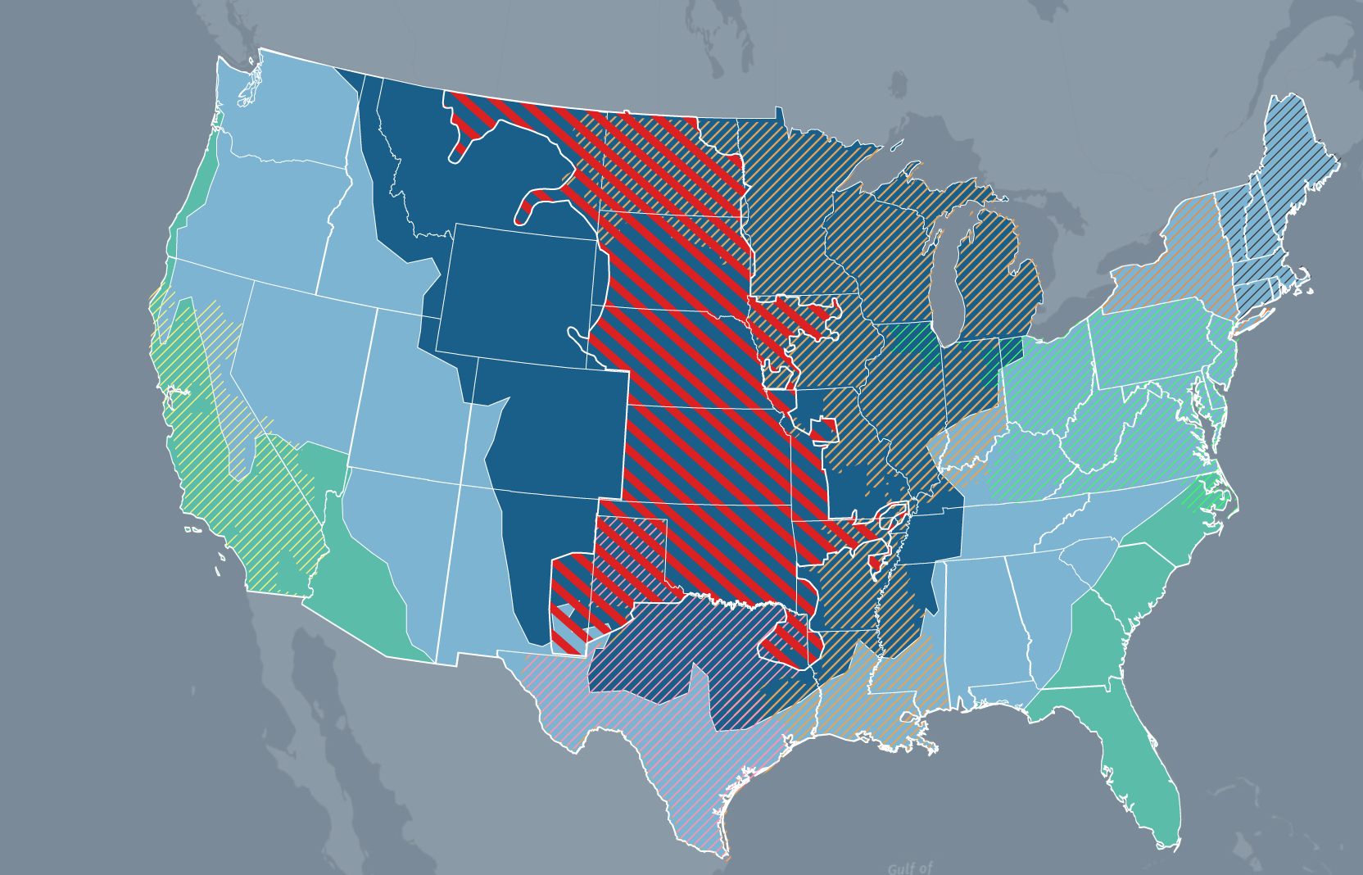

SPP REGION
IN COLDEST part of u.s.
ISO-NE
NYISO
MISO
PJM
SPP
CAISO
ERCOT
* Locations of ISOs/RTOs are approximate

Slide 4
Operations data

Slide 5
Interruptions by entity
Required interruptions were allocated to transmission operators on pro-rata basis
Participating Entity | % of MW
CSWS | 16.8
WAPA | 13.5
SPS | 12.4
OKGE | 12.4
KCPL | 9.68
WR | 8.49
NPPD | 6.57
OPPD | 4.6
WFEC | 3.78
GRDA | 2.22
SECI | 2.22
EDE | 2.19
LES | 1.36
SPRM | 1.22
KACY_N | 0.92
CBPC | 0.83
INDN | 0.38
SPA | 0.28
TSGT | 0.13
SPP Total | 100%
2,718 MW
(~6.5% of BA Load)
1359 MW
(~3.2% of BA Load)
610 MW
(~1.5% of BA Load)

Slide 6
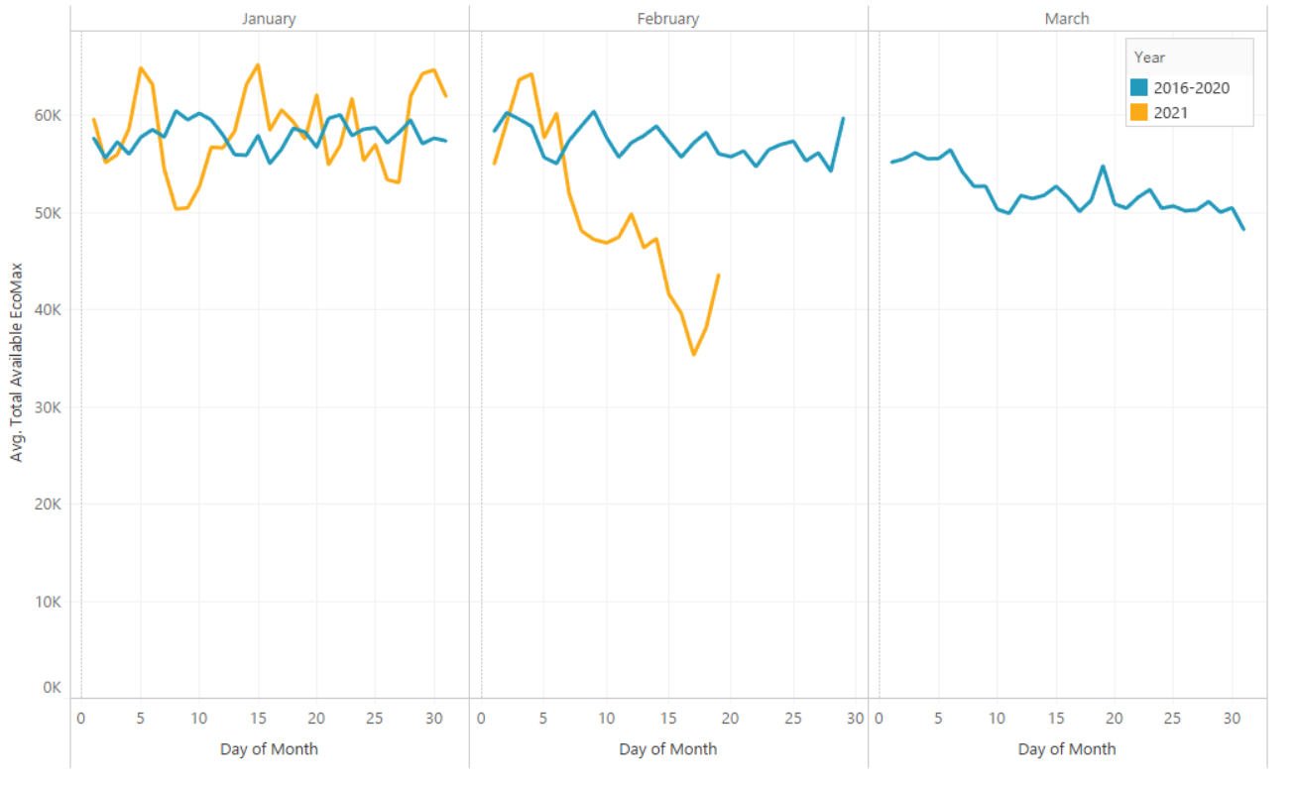
available Generation in SPP Market
Average Available Generation
Extreme weather reduced available generation by ~20 GW below historical Feb. average

Slide 7
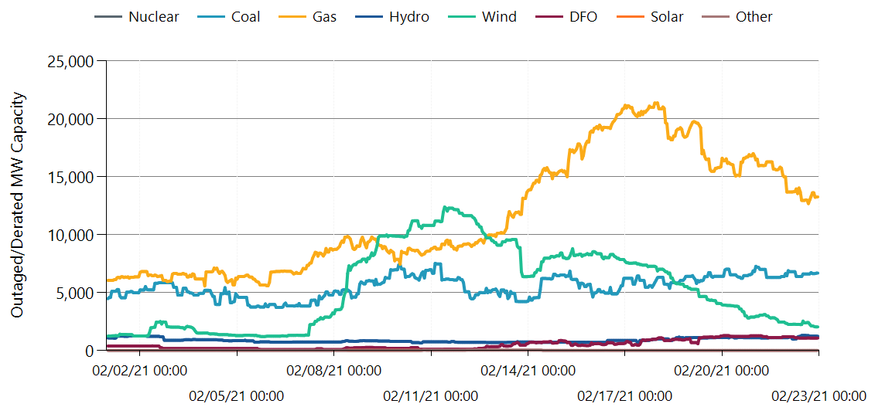
During peak conditions,
gas generation contributed to ~60% of total unavailability
Wind generation outages ~5x more than first week of Feb
GENERATING CAPACITY OUTAGES
Fuel Oil
Energy Emergency Alerts in Effect

Slide 8
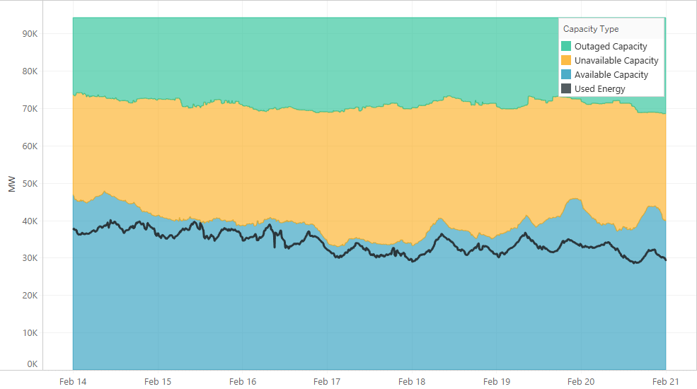
Total GENERATING Capacity in SPP
2/15 EEA3
2/16 EEA3
Available generation during EEA3 periods constituted ~65% of accredited capacity.

Slide 9
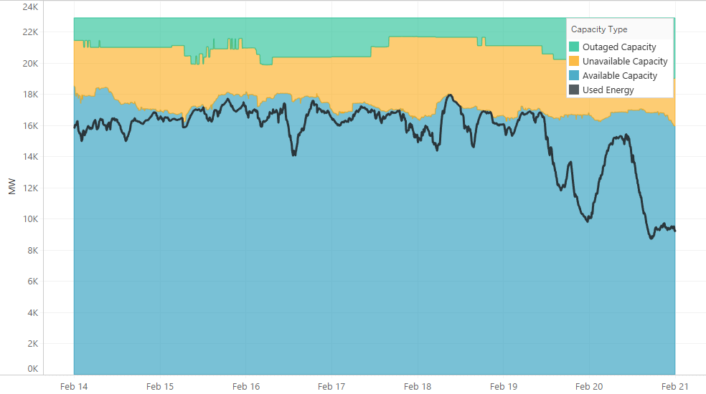
Generating Capacity in SPP – Coal
2/15 EEA3
2/16 EEA3
Coal generation during EEA3 periods constituted ~80-82% of accredited capacity.

Slide 10
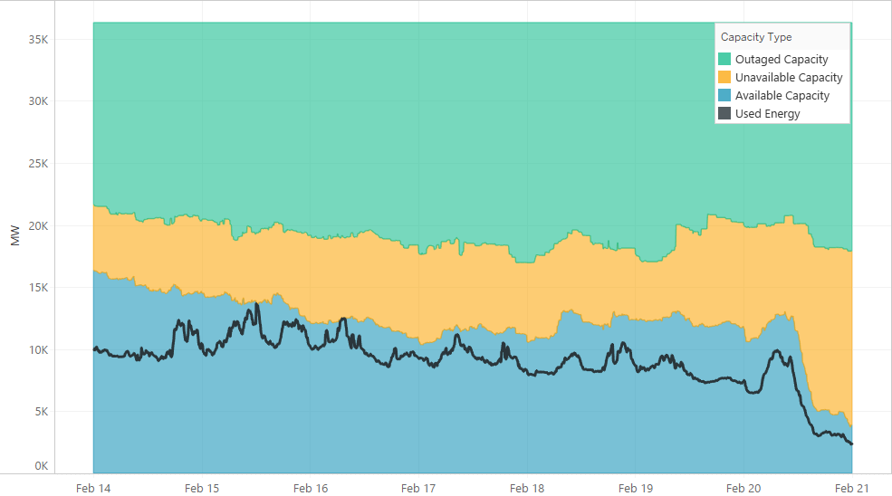
Generating Capacity in SPP – Gas
2/15 EEA3
2/16 EEA3
Gas generation during EEA3 periods constituted ~42-48% of accredited capacity.

Slide 11
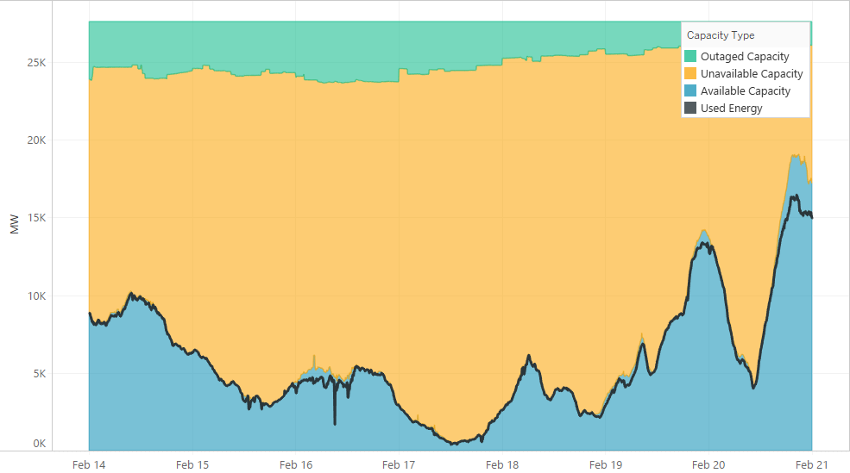
Generating Capacity in SPP – Wind
2/15 EEA3
2/16 EEA3
Wind generation during EEA3 periods constituted ~90-115% of accredited capacity.

Slide 12
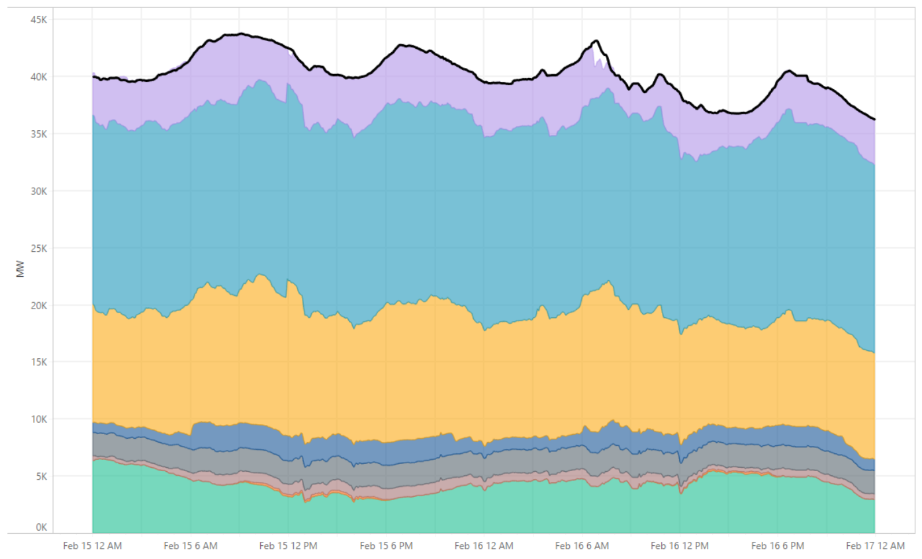

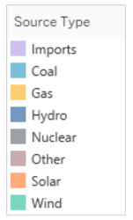
Energy that met Demand in
Real-Time Market
SPP relied on energy from multiple sources, including imports from neighbors
2/15 EEA3
2/16 EEA3

Slide 13
Natural Gas Prices

Slide 14
Natural gas hub prices

Slide 15
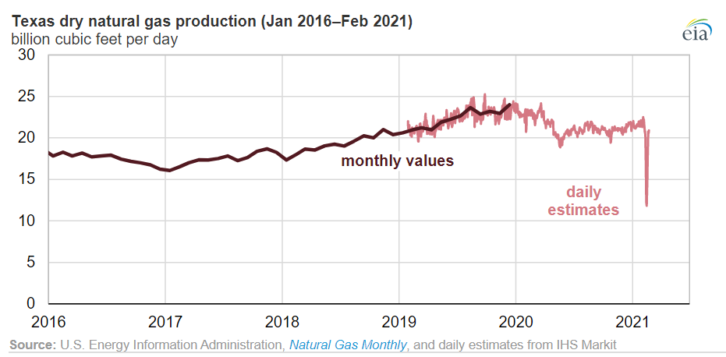
Natural gas supply dropped significantly
https://www.eia.gov/todayinenergy/detail.php?id=46896
Notes:
During the cold snap that affected much of the central part of the country, U.S. dry natural gas production fell to as low as 69.7 billion cubic feet per day (Bcf/d) on February 17, a decline of 21%, or down nearly 18.9 Bcf/d from the week ending February 13. Natural gas production in Texas fell almost 45% from 21.3 Bcf/d during the week ending February 13 to a daily low of 11.8 Bcf/d on Wednesday, February 17, according to estimates from IHS Markit. Temperatures in Texas averaged nearly 30 degrees Fahrenheit lower than normal during the week of February 14.
The decline in natural gas production was mostly a result of freeze-offs, which occur when water and other liquids in the raw natural gas stream freeze at the wellhead or in natural gas gathering lines near production activities. Unlike the relatively winterized natural gas production infrastructure in northern areas of the country, natural gas production infrastructure, such as wellheads, gathering lines, and processing facilities, in Texas are more susceptible to the effects of extremely cold weather. https://www.eia.gov/todayinenergy/detail.php?id=46896

Slide 16
Communications

Slide 17
SPP Balancing authority Operations: Feb. 4-20, 2021
Time blocks are not to scale
Thurs. 2/4 to Mon. 2/8
Tues 2/9 to Sat. 2/13
Sun. 2/14
Mon. 2/15
Tues. 2/16
Wed. 2/17
Thurs. 2/18
Fri. 2/19
Sat. 2/20
Normal operations in effect
Tues. 2/9: Declared conservative operations until further notice
Thurs. 2/11: Began to commit generating resources multiple days in advance
for Sat. 2/13
to Tues. 2/16
Sat. 2/13: Reminded market participants of emergency cap & offer processes
Requested member companies issue public appeals for conservation
Declared EEA1 to be effective 2/15 at 05:00
Conservative operations
in effect
EEA2
in effect
EEA 2
in effect
EEA1
in effect
EEA1
in effect
Conservative operations in effect
Thurs. 2/4: Issued cold weather alert to grid operators
05:00
Declared EEA1
06:15
Declared EEA3
07:22
Declared EEA2
06:44
Demand interruption
09:30
Ended EEA and remained in
conservative operations
through 22:00
Sat. 2/20, with appeal for public conservation
09:20
Ended EEA and remained in
conservative operations
through 22:00
Sat. 2/20, with appeal for public conservation
10:08
Declared EEA3
New record peak
10:07 – EEA3
12:04 - Demand interruption
11:30
Declared EEA2
12:31
Declared EEA1
13:01 - EEA3
13:15
Declared EEA1
Mon. 2/8: Issued resource alert to
grid operators:
“Implement resource preparations…ensure resource commitment start-up and run times ...report fuel shortages & transmission outages…”
14:00
Declared EEA2
18:28
Declared EEA2
18:20
Declared EEA2
18:25 – Declared
EEA1
22:00 Declared
normal operations
22:59
Declared EEA1

Slide 18
Next Steps

Slide 19
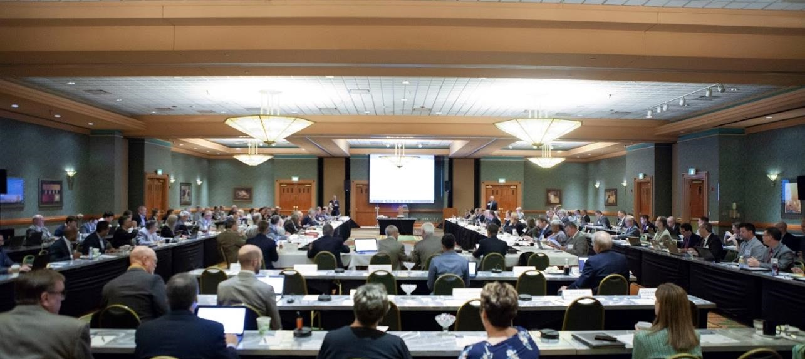
After the storm
Collaborate with members and industry to ensure region
is equipped to manage future crises effectively
Comply with FERC and NERC inquiries
Review processes for improvement areas
Document lessons learned

